Slide 1
Capstone Project Women Empowerment
DEVELOPED BY-
Padma Uppalapati
Muthukumar N K
Himanshu Sharma
Nikhil Ahire
Pavuluri Pinakapani Balaji
Minto Larsen
Mentor:
Mr. Rajashekar

Slide 2
Table of contents
Introduction
Aim of project
Objective
System requirements
Technologies
Project Modules
Problem statement
Scope
Project Screenshots

Slide 3
INTRODUCTION
Developing this application aims at providing the scheme initiated by the Government of India as an integrated package of the following services to women
Enable them to become economically more viable, independent and raise their socio-economic status.
This application will collaborate all the various sectors of scheme and provide a platform for women to become self-dependent.
This application consists of the scheme related to Social Welfare and Financial services for women.

Slide 4
PROBLEM STATEMENT
Application to be developed is a Women Empowerment Web Application. The application will implement all of the CRUD operations on database. The goal of our application is to provide a quick and easy to use interfaces for all users.
The website will be a part of Ministry of Women and Child Development that allows a set of trainees and NGOs to register for different purposes.
Administrative privilege will be provided to monitor the information regarding each registration and to approve or reject it.

Slide 5
AIM OF PROJECT
Developing this application aims at providing the scheme initiated by the Government of India as an integrated package of the following services to women and enable them to become economically more viable, independent and raise their socio-economic status.
This application will collaborate all the various sectors of scheme and provide a platform for women to become self-dependent. This application consists of the scheme related to Social Welfare and Financial services for women.

Slide 6
OBJECTIVE
To provide skills that give employability to women.
To provide skills that enable women to become self-employed/entrepreneurs.
This scheme is intended to benefit women who are in the age group of 16 years and above.
In this scheme the beneficiaries will be registered under an NGO, that will be providing the training and employment programme.

Slide 7
SYSTEM REQUIREMENTS
SOFTWARE
HARDWARE
JDK 1.8
MongoDB 14
Eclipse IDE
VS Code Editor
Postman
Disk space: 1GB or above
RAM : 2GB or above

Slide 8
TECHNOLOGIES USED
Spring boot 2.5
Angular 8
CSS3
HTML5
JPA 3.0
JUnit Jupiter
Swagger

Slide 9
PROJECT MODULES
1. Admin Dashboard
2. NGOs
3. Support to Training and Employment Programme for Women (STEP)
4. Home Page
5. STEP Dashboard
6. Legislations and Policy
7. Registration Section
8. Status Section
9. FAQ Section
10. Criteria Section
11. Organizations
12. Funding Norms

Slide 10
USER & ADMIN: Characteristics
User:
Register & Login as a Trainee/NGO
View FAQ section and Legislations & Policy
Admin:
Login to view list of ngo’s/trainees
Update/Delete specific NGO/Trainee
Approve/Reject any NGO/Trainee application
Add new NGO/Trainee

Slide 11
NGO & STEP:Characteristics
NGO:
Login to view the list of NGO’s and details of Funding Norms
View the criteria to register the organization in the STEP scheme
Register his/her organization into MWCD
View the application status as Pending/Approved/Rejected
Trainee :
Login to view list of variable training sectors
View list of Organizations working in STEP program
Register themselves in STEP training programmes
View the application status as Pending/Approved/Rejected

Slide 12
PROJECT SCREENSHOTS

Slide 13
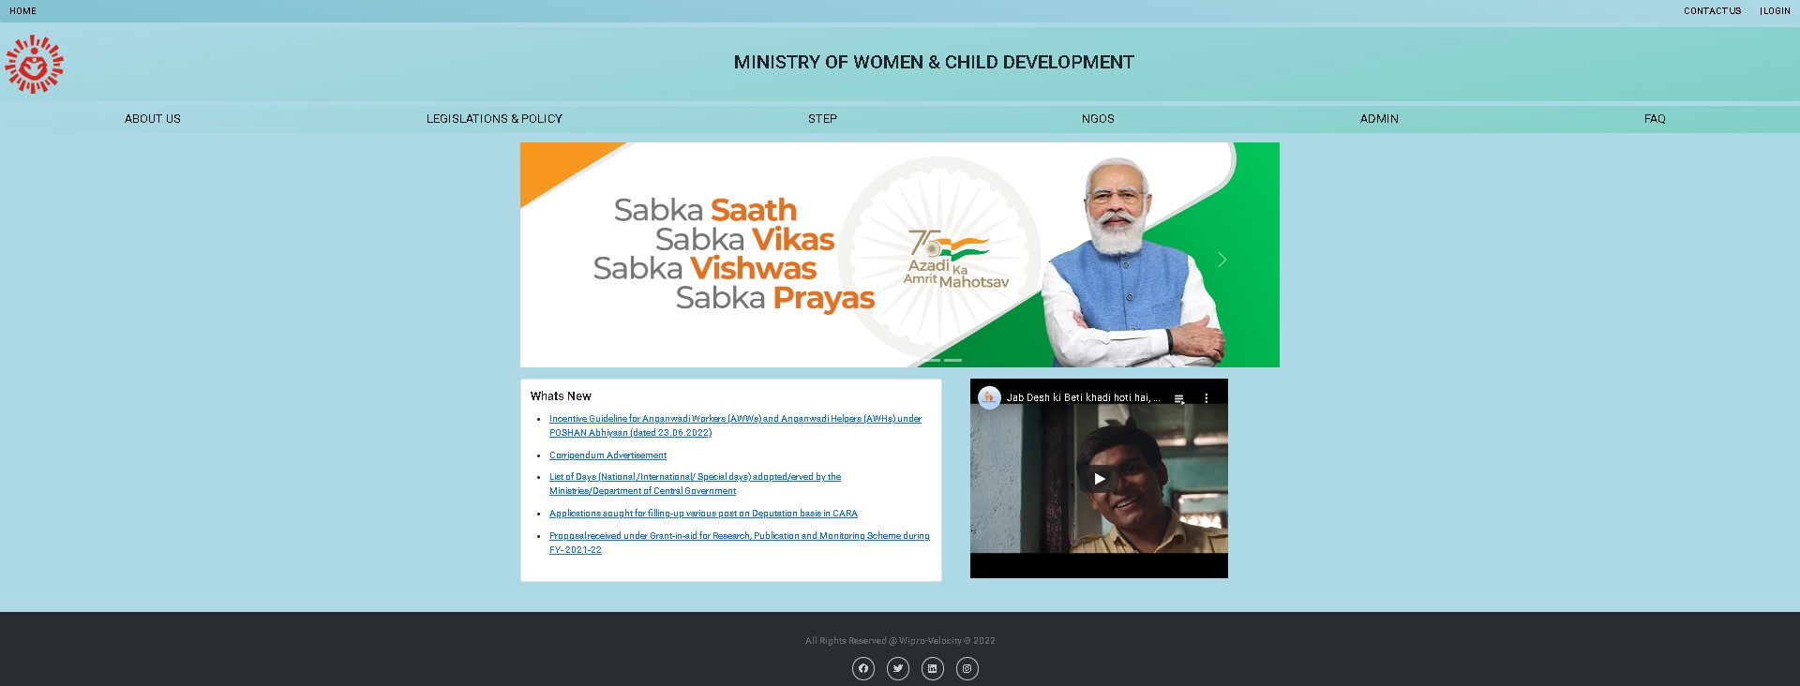
HOME

Slide 14
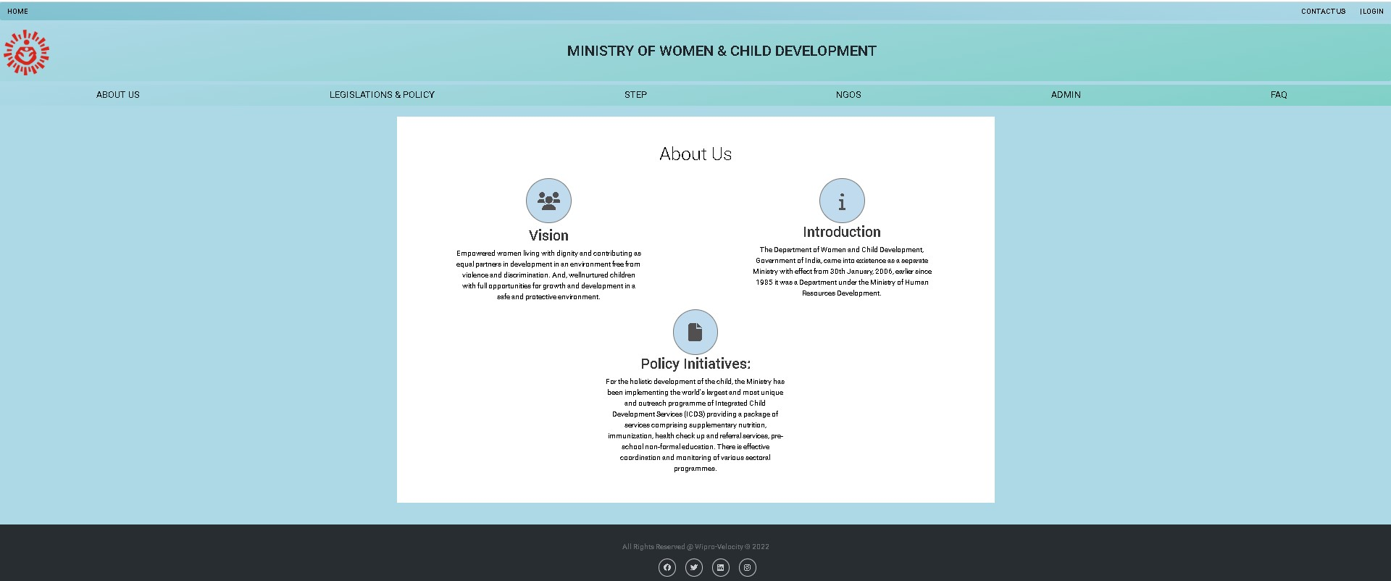
ABOUT US

Slide 15
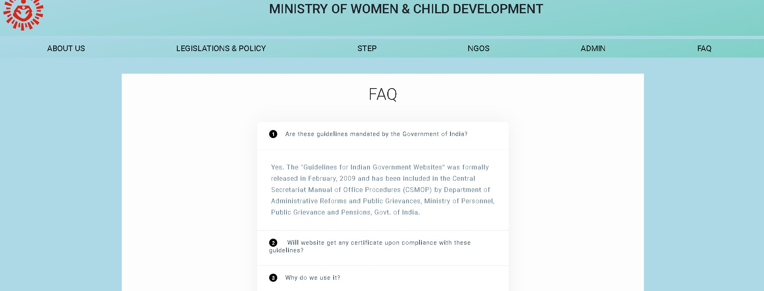
FAQ

Slide 16
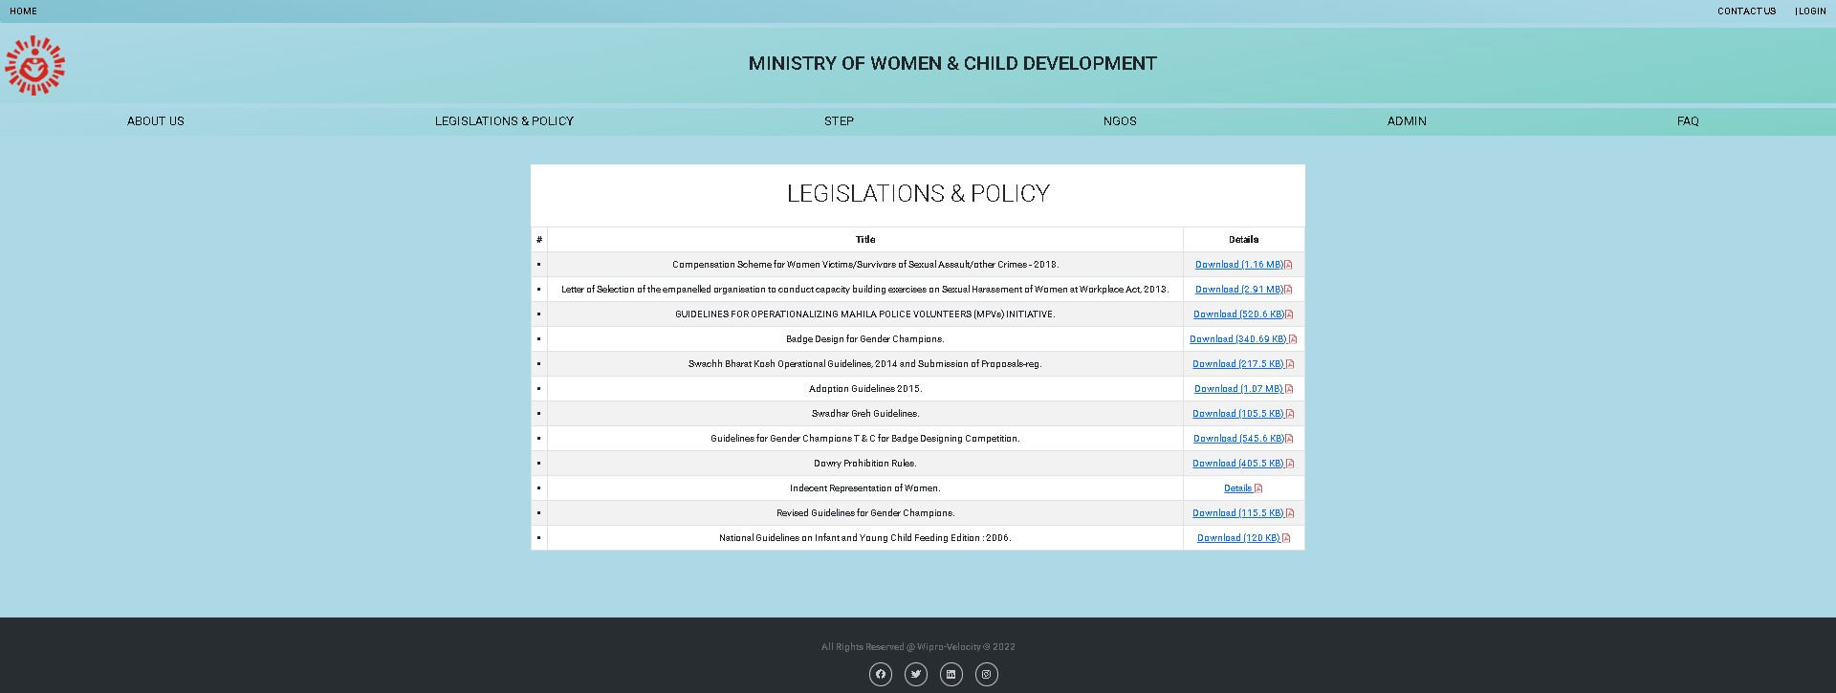
LEGISLATIONS & POLICY

Slide 17
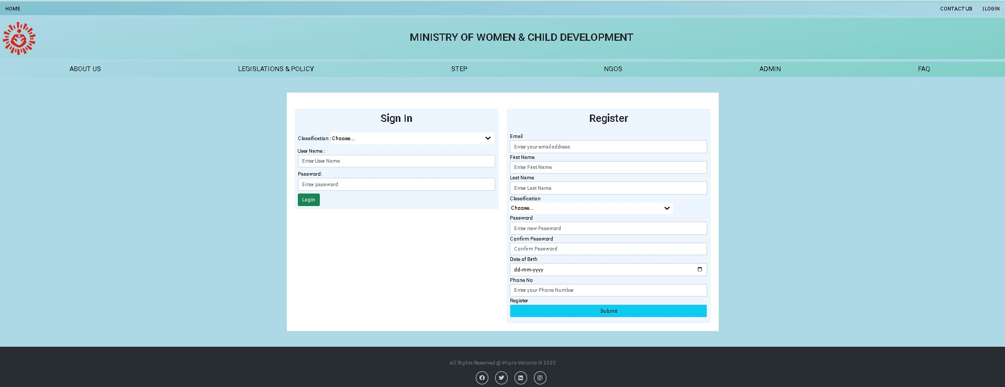
User: Register & Login Trainee/NGO

Slide 18
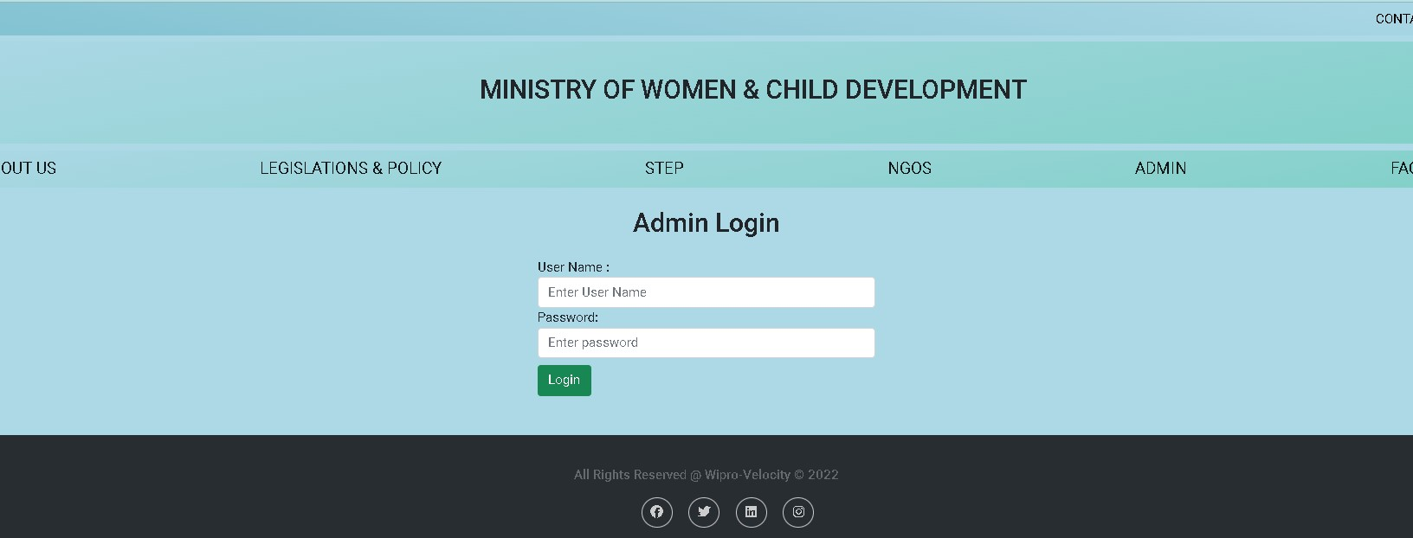
Admin: Login to view list of ngo’s/trainees

Slide 19
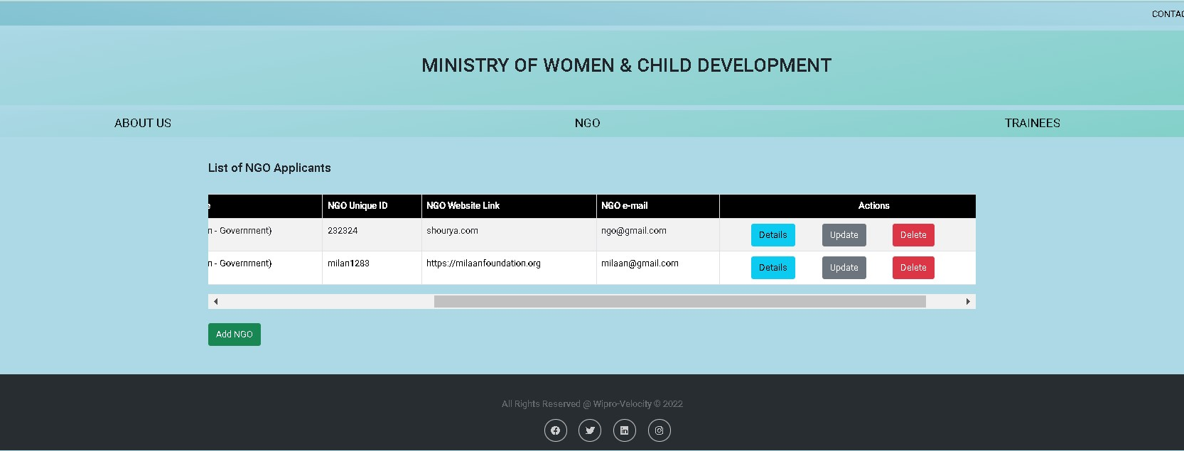
ADMIN : UPDATE NGO LIST

Slide 20
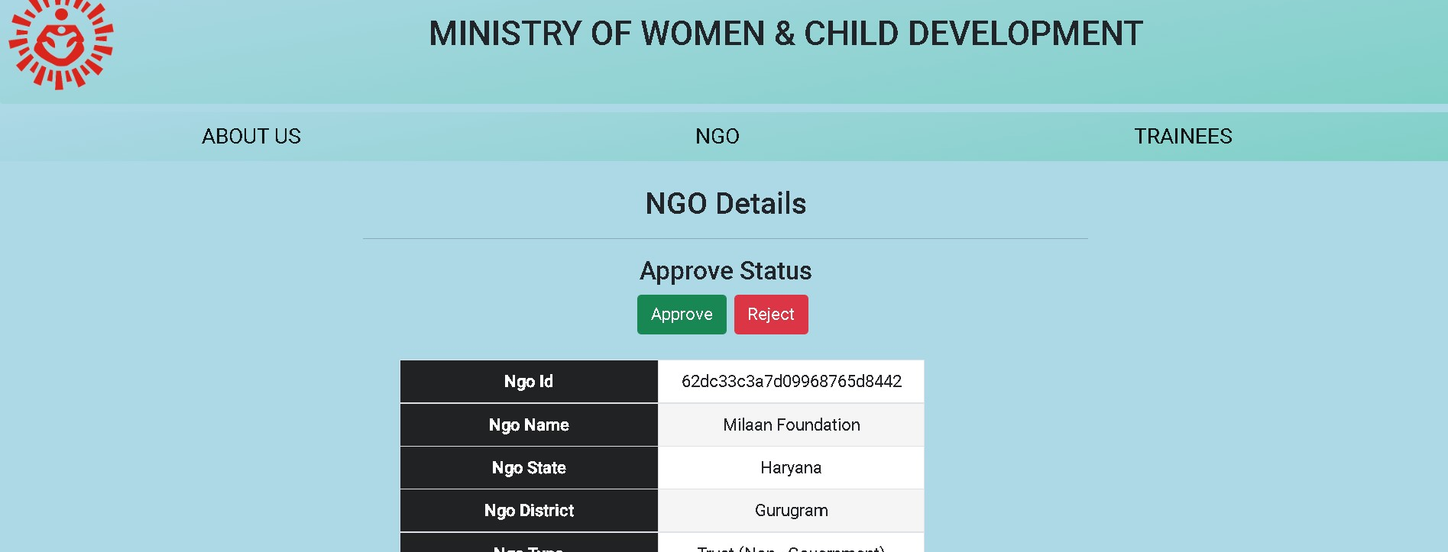
ADMIN :APPROVE NGO DETAILS

Slide 21
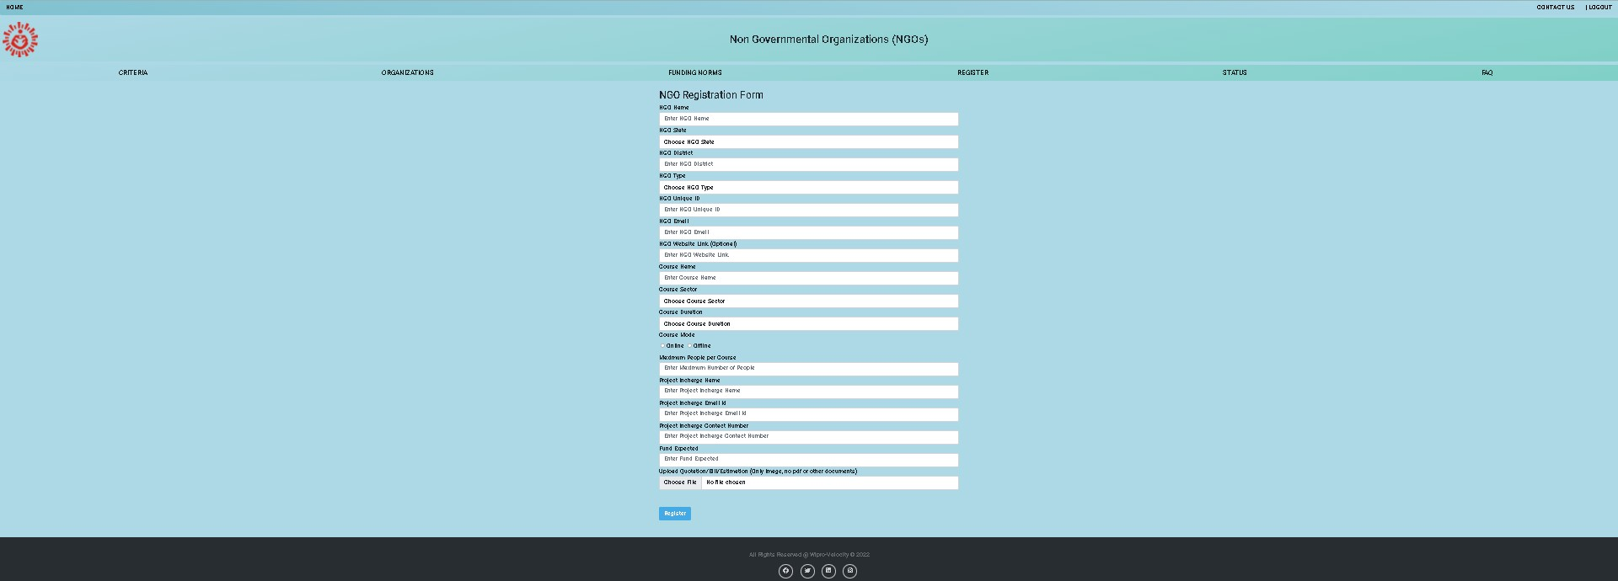
NGO REGISTER

Slide 22
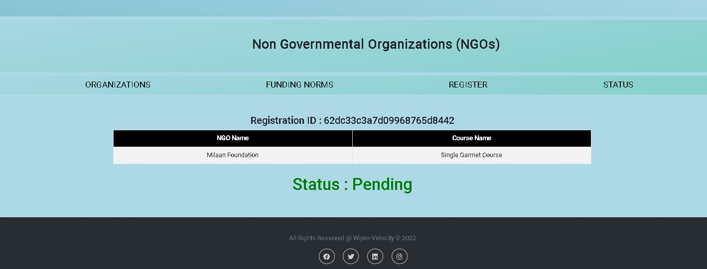
NGO :STATUS(Pending)

Slide 23
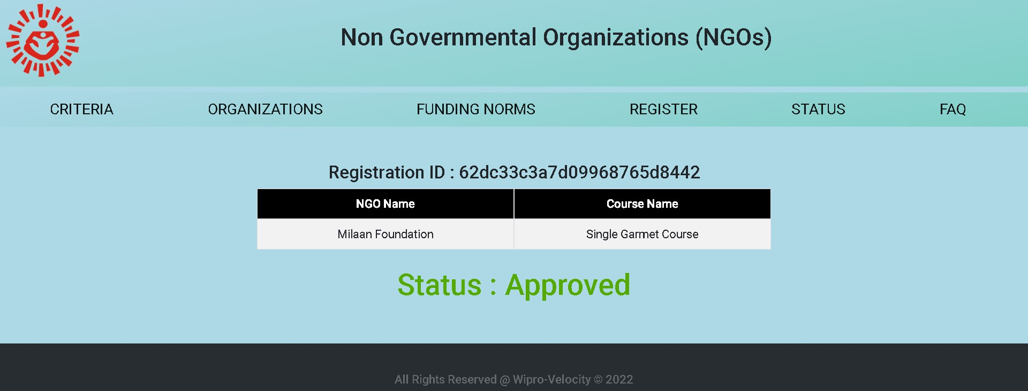
NGO : STATUS (Approved)

Slide 24
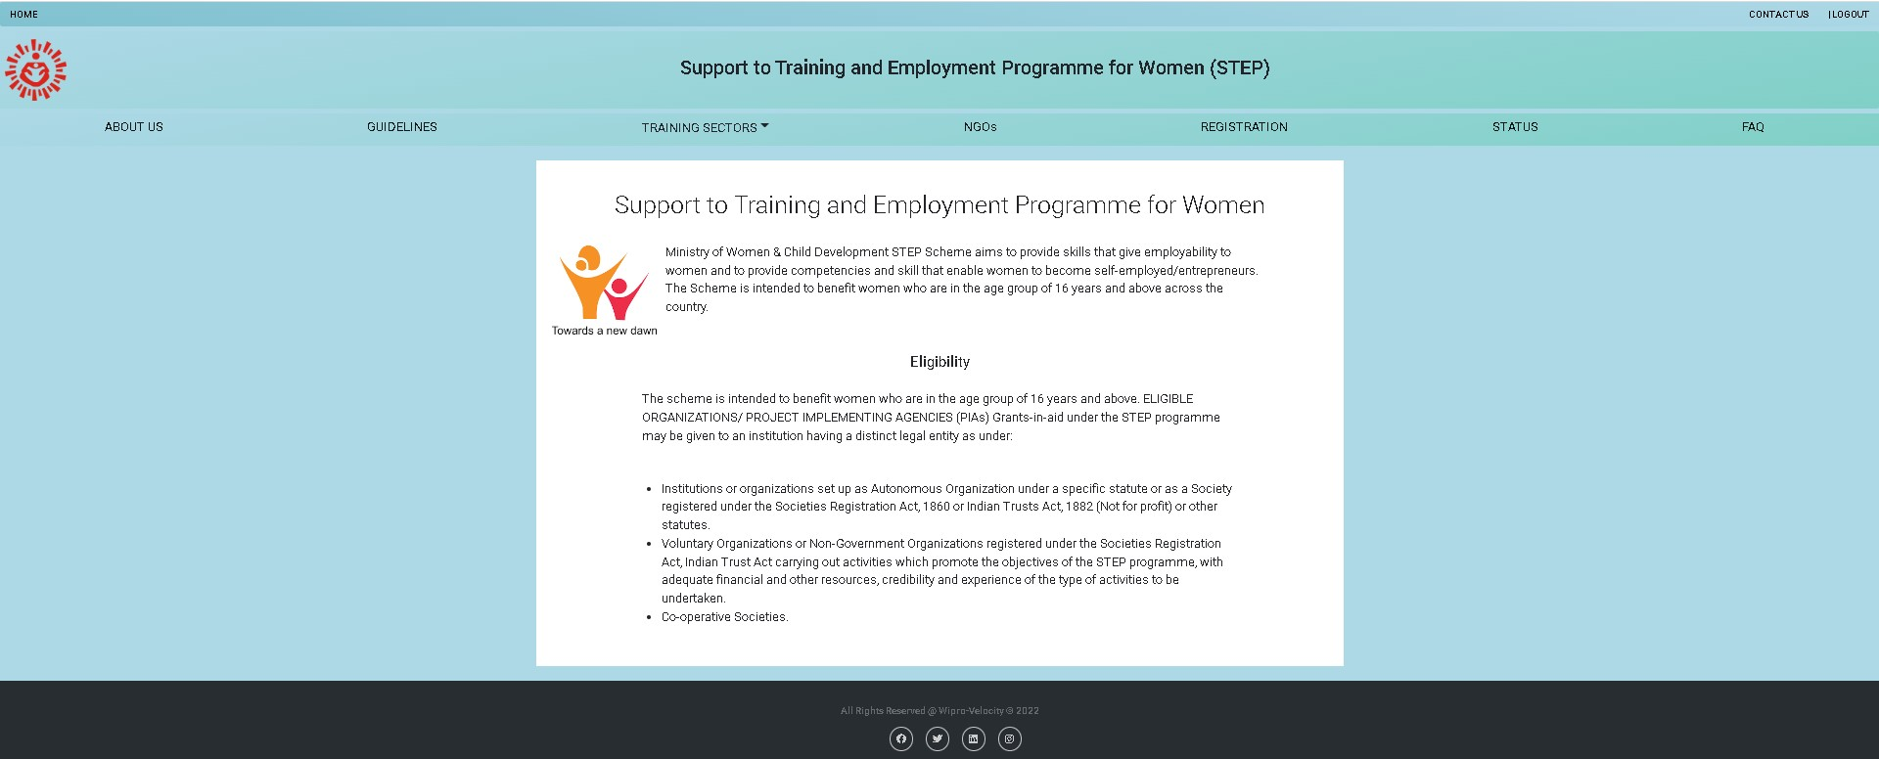
STEP: HOME

Slide 25
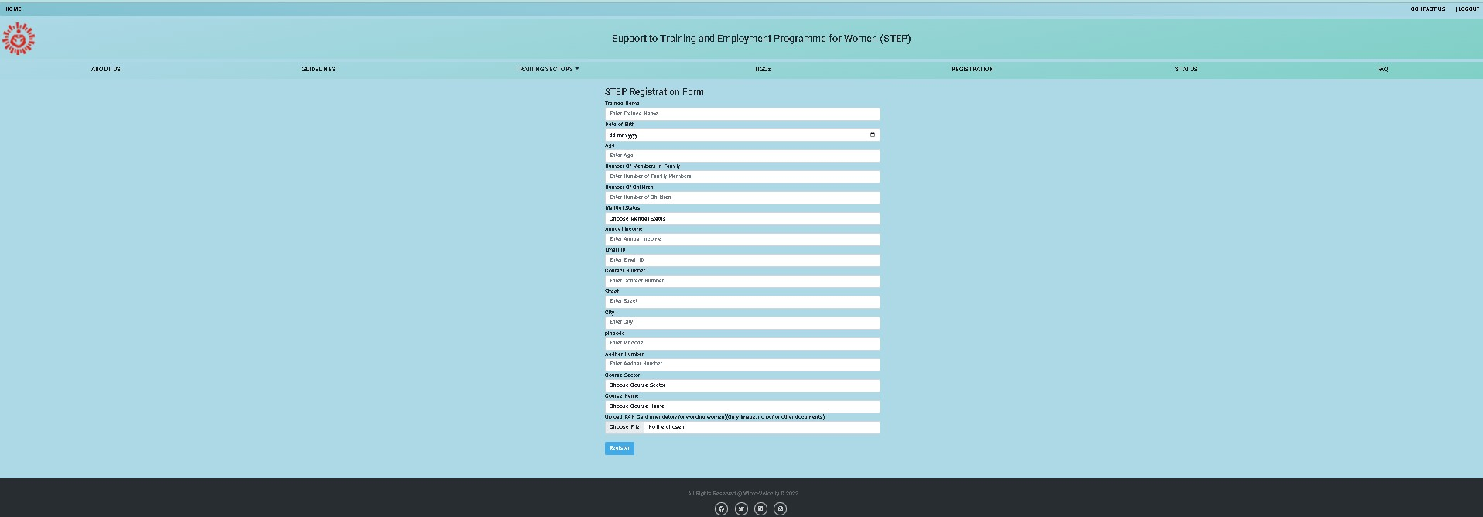
STEP: REGISTER

Slide 26
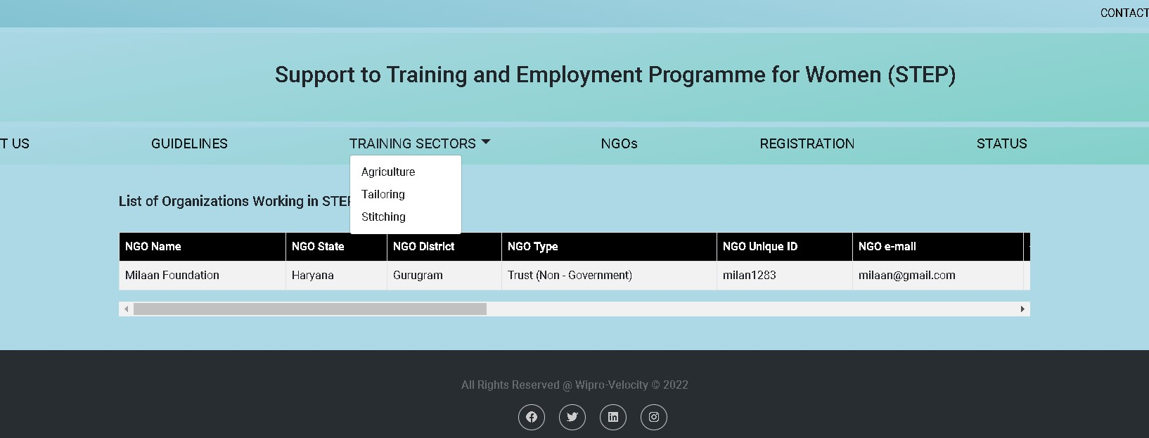
STEP: LIST

Slide 27
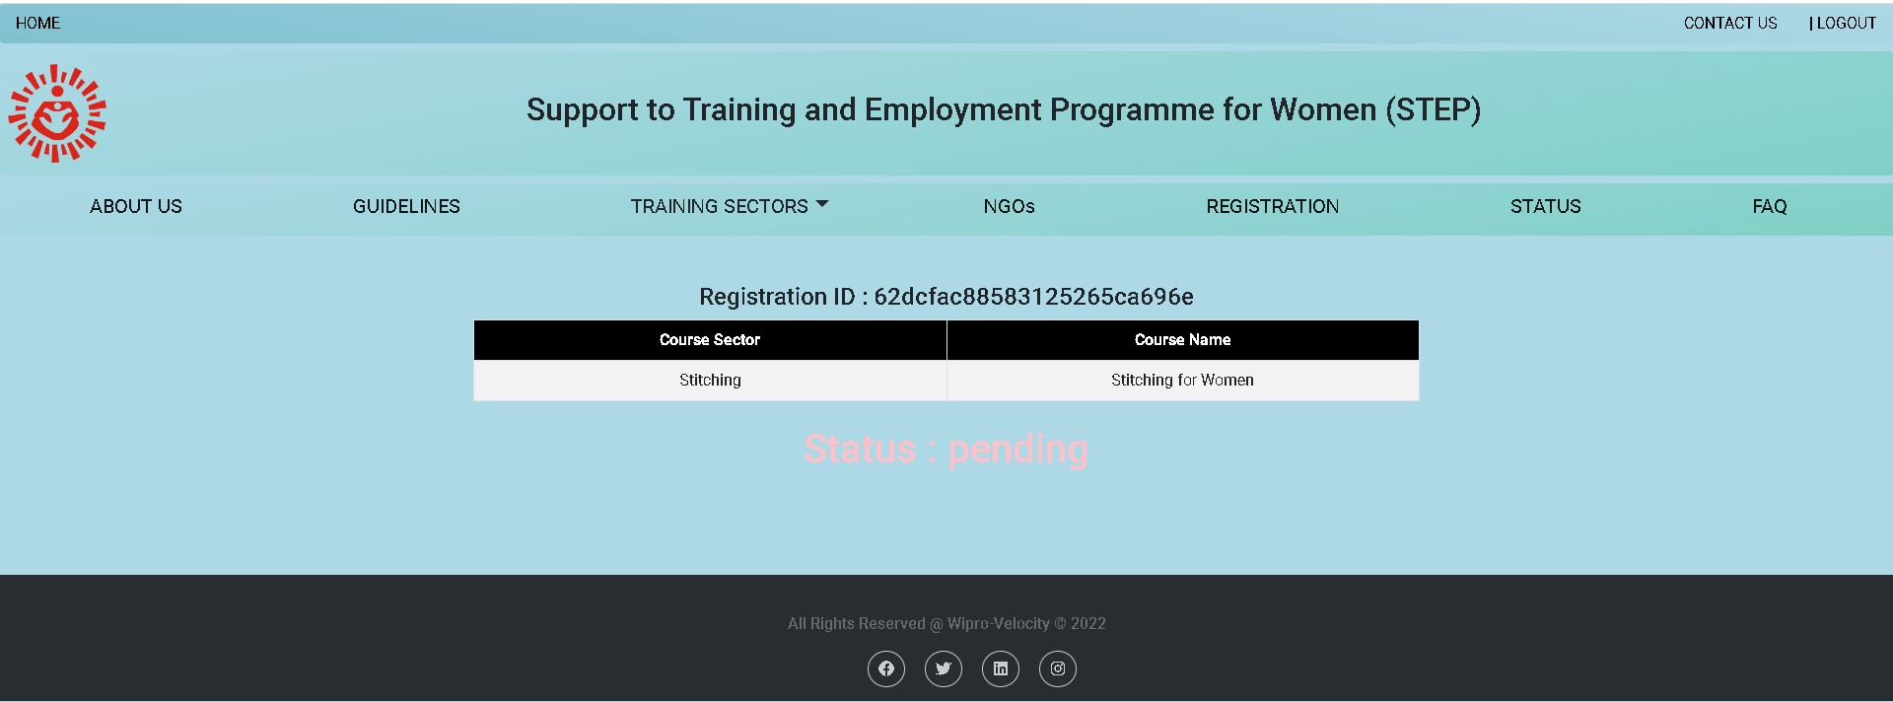
STEP: STATUS(Pending)

Slide 28
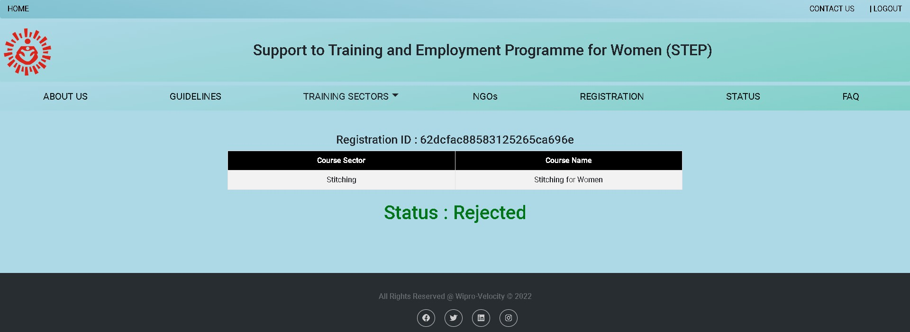
STEP: STATUS(Rejected)

Slide 29
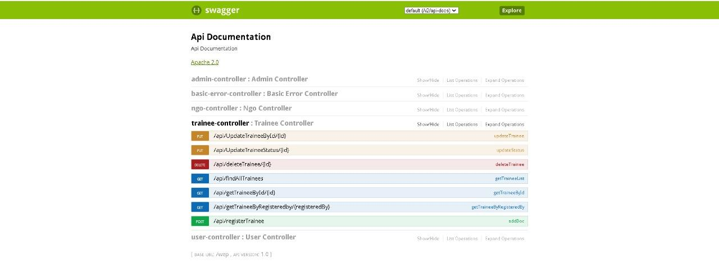
SWAGGER

Slide 30
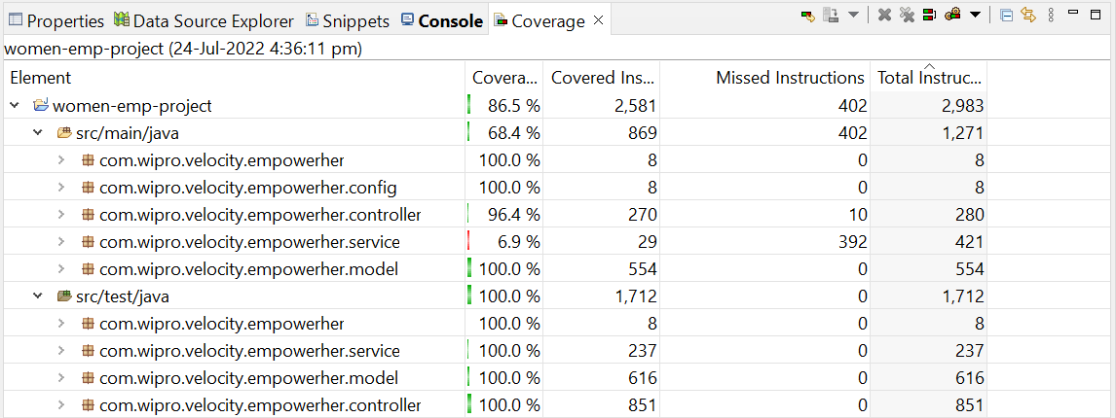
JUNIT: Testing

Slide 31
Thanks!

